Slide 1
Question 223.37.1
Suppose we have a biological system that uses sodium ions (+1q_{e}) in which we have a current density, J. If we could get the organism to switch to Calcium ions (+2q_{e}), the current density would
Increase
decrease
stay the same?

Slide 2
Question
What do we mean by conductivity?
The material properties of the conductor that determine how easy it is for free charge to flow.
The ability of the material to polarize, therefor leaving “extra” charge on the surface forming a surface charge density.
The affinity of the material to have low bound electrons that can contribute to an electric current.
The ability to work for railroad companies as a guide for passengers.

Slide 3
Question 223.37.2
If the conductivity is 6.0×10⁷Ω⁻¹m⁻¹ what is the resistivity?
1. 6667×10⁻⁸m Ω
3.45×10 ⁻⁹ m Ω
6.7×10⁸m Ω
5.5⁸⁴m Ω

Slide 4
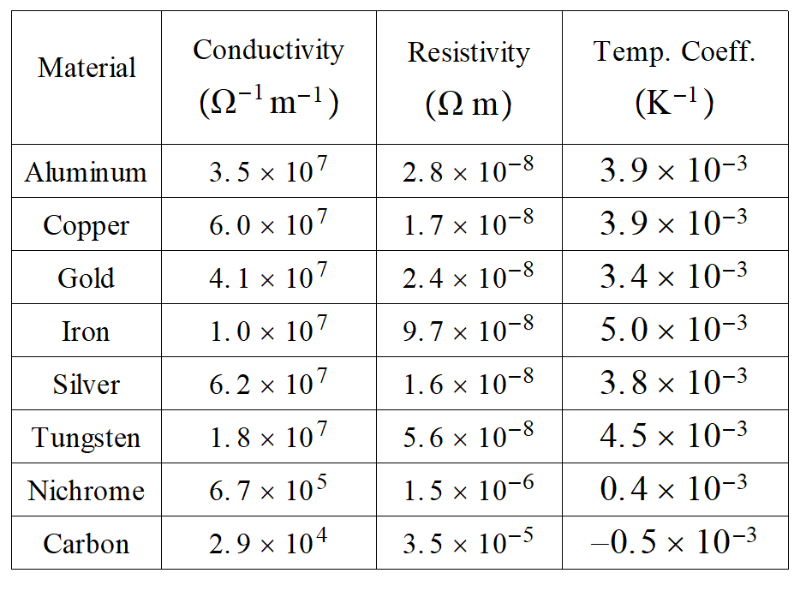

Slide 5
Question 223.37.3
The thermal resistivity coefficient for tungsten is 4.5×10⁻³. As the tungsten heats up, the resistivity will…
increase
decrease
go away
Stay the same

Slide 6
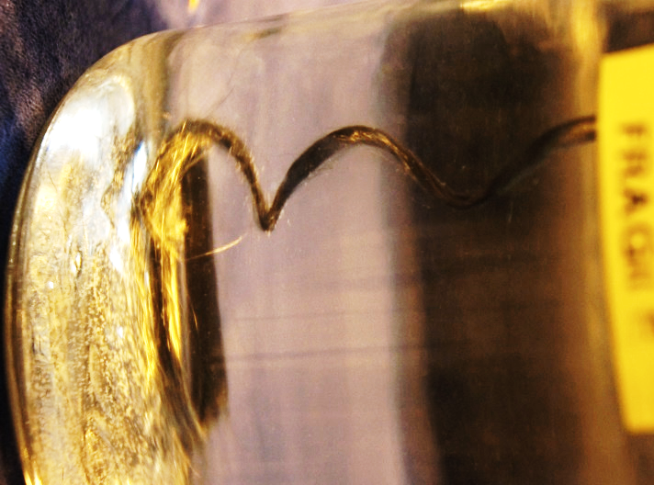
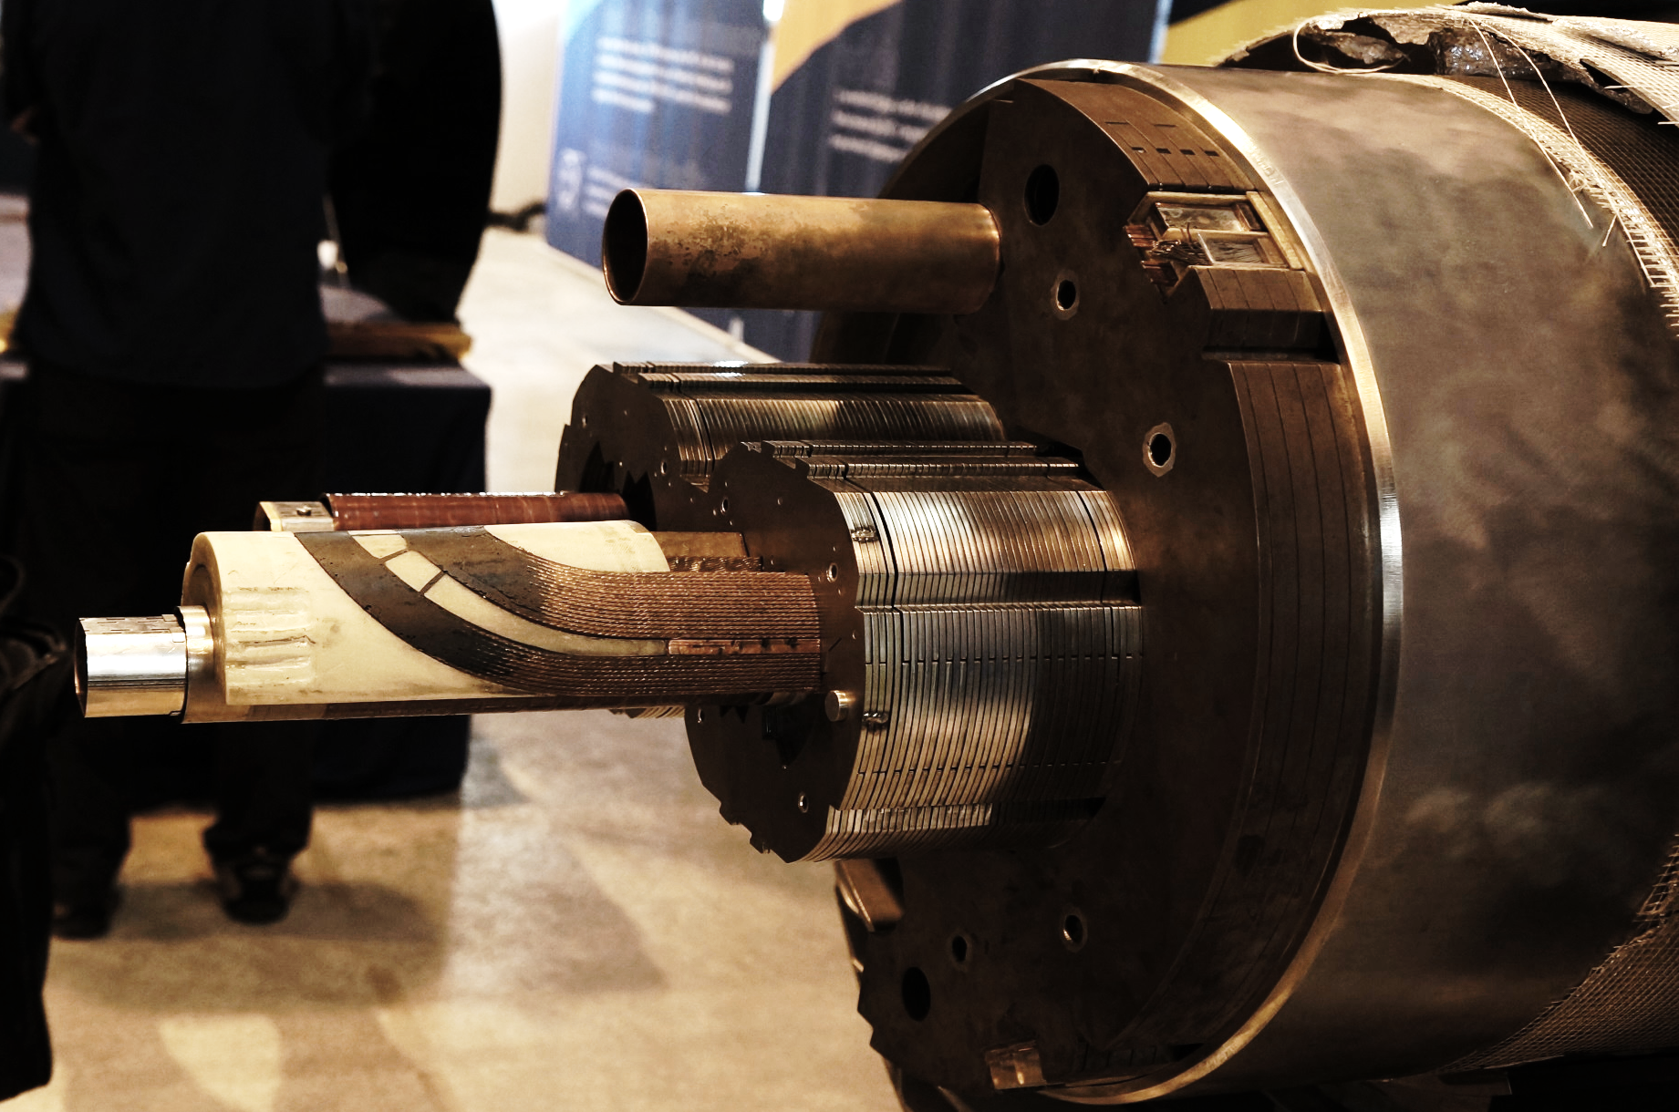
Superconducting fibers

Slide 7
Question 223.37.4
If a wire is cut in half so the wire is now half the original length, the resistance of the remaining piece will be
Larger
Smaller
The same
As that of the whole piece

Slide 10
Question 223.37.4.5
You start your care in the winter. Since it is dark outside you turned on your lights before you tried to start the car. You notice that when the starter motor turns, the lights dim. Why?
The battery can’t supply enough current so you are running out with both the lights and the starter motor working.
Your battery is damaged by freezing.
Because of the internal resistance in the battery, the voltage supplied has dropped below 12 volts.
Alians

Slide 14
Question 223.37.5
You double the voltage across a certain conductor and you observe the current increases three times. What can you conclude?
1) Ohm’s law is obeyed since the current still increases when V increases
2) Ohm’s law is not obeyed
3) This has nothing to do with Ohm’s law

Slide 15
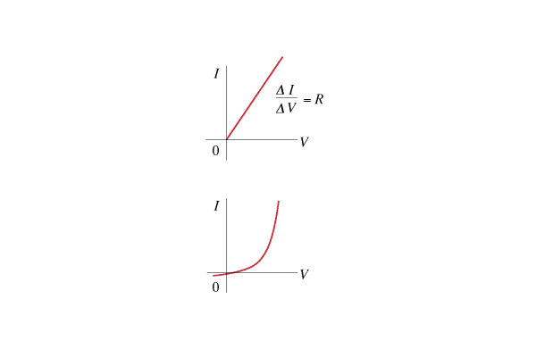
Question 223.37.5
You double the voltage across a certain conductor and you observe the current increases three times. What can you conclude?
1) Ohm’s law is obeyed since the current still increases when V increases
2) Ohm’s law is not obeyed
3) This has nothing to do with Ohm’s law
Ohm’s law, V = I R, states that the relationship between voltage and current is linear. Thus for a conductor that obeys Ohm’s Law, the current must double when you double the voltage.
Follow-up: Where could this situation occur?

Slide 16
Question 233.37.6
Where is the most probable place to find a magnetic monopole (a free magnetic north pole or south pole on it’s own)
In the beam of linear accelerators
In pieces of broken magnets
In atoms
In science fiction novels

Slide 17
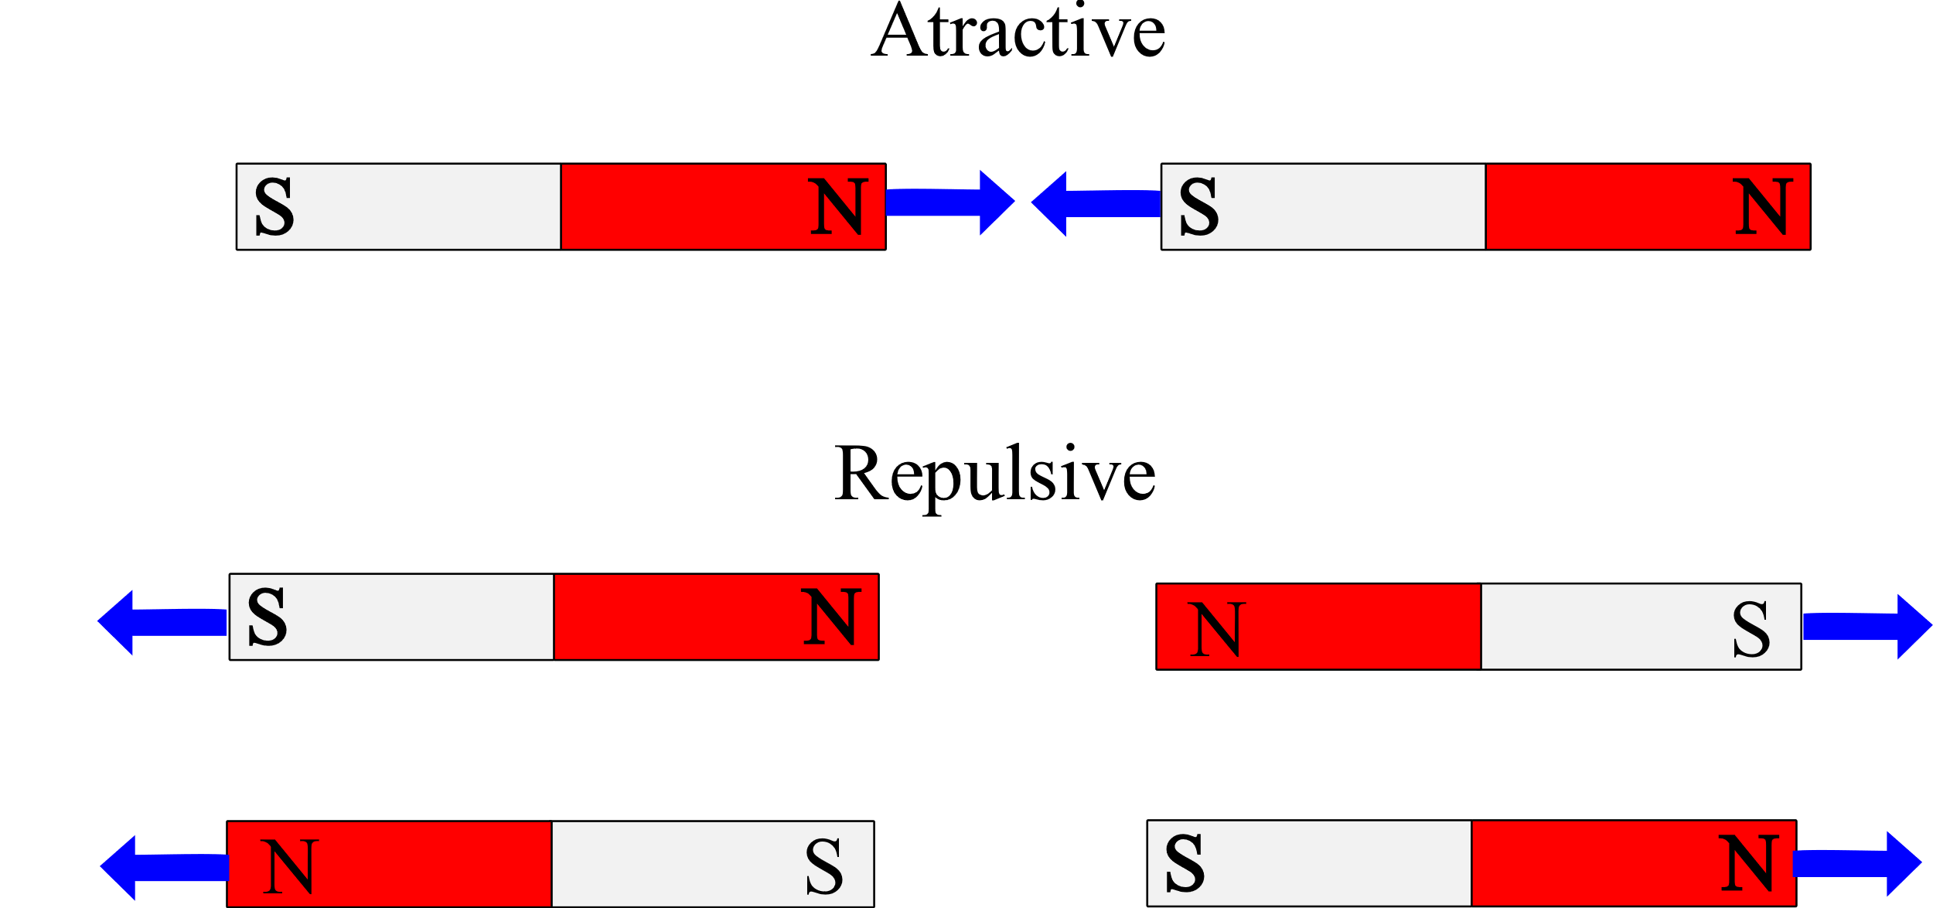

Slide 18
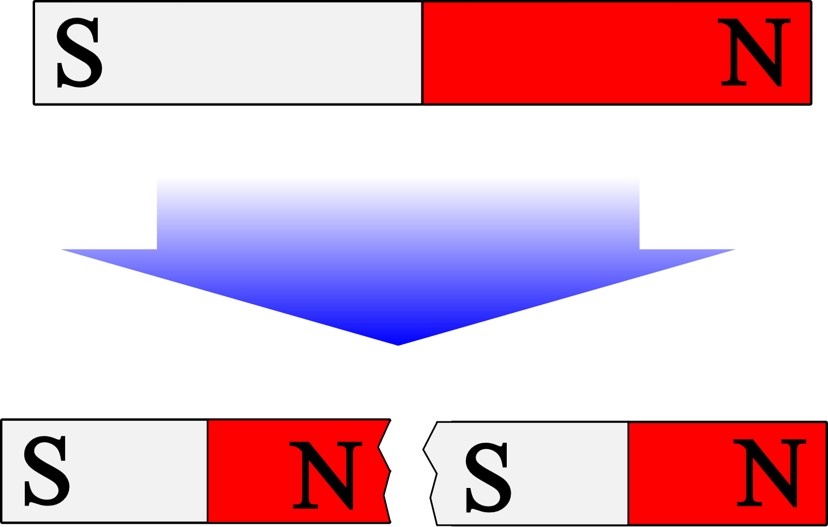

Slide 19
